Slide 1
Final Project
Team 3
IST 687 Fall 2022

Slide 2
Data Set Content
Variables
Age
Sex
BMI
Children
Smoker
Region
Charges
Data Source - Medical Cost Personal Datasets | Kaggle
Observations – 1338

Slide 3
Original Business Questions
What are the demographics of our patient population?
What variables have the most effect on insurance charges?
How can we predict an individual's insurance cost based on their variables/ how accurately can we forecast costs for each patient by looking at the data?
What variables in the dataset can an individual control to potentially reduce their insurance charges, and by how much?
Other than behavior of individuals such as smoking, what can cause increase of medical cost?
What variables have the strongest correlation?

Slide 4
Demographics
Gender:
Female - 48.48%
Male – 50.52%
Percentage Smokers:
Smoker – 20.48%
Non-smoker – 79.52%
Population by Region:
Southwest – 325
Southeast – 364
Northwest – 325
Northeast – 324
Average Age: 39.21 years
Range: 18-64
Average BMI: 30.66
Range: 15.96-53.13
Average Children: 1.09
Range: 0-5
Average Charges: $13,270.42
Range: $1,121.87-$63,770.43

Slide 5
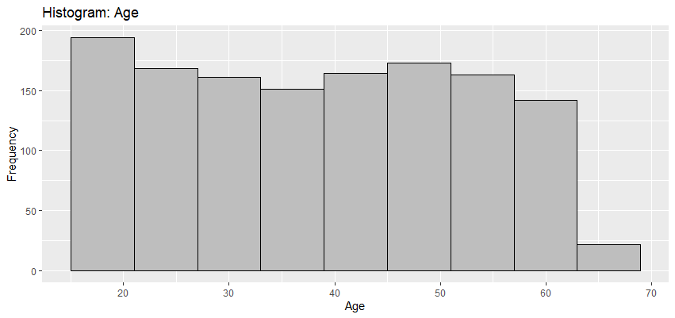
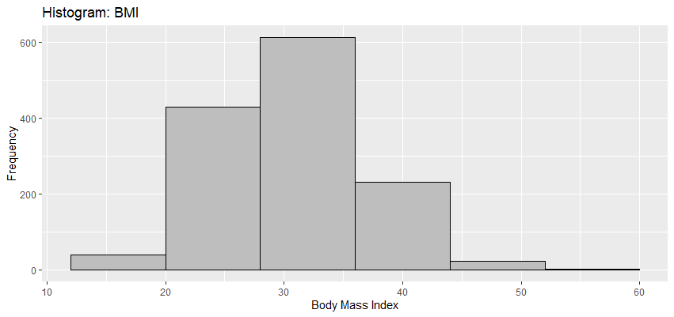
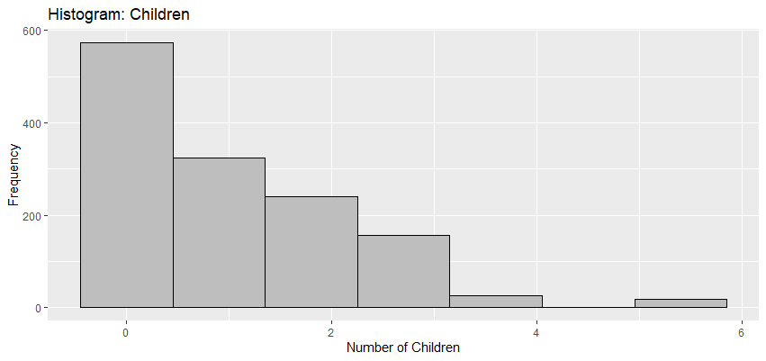
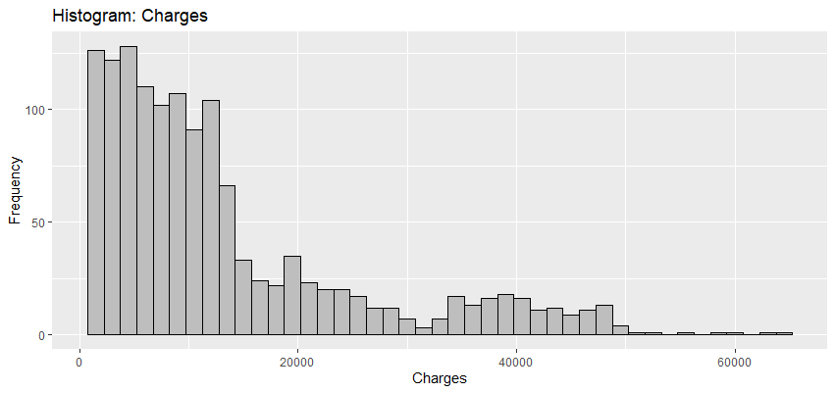

Slide 6
Multivariate Linear Regression Model
Initial Regression Model
charges = age + bmi + children + female + smoker + southwest + southeast + northwest
F-statistic = < 2.2e-16
Adjusted R-squared: 74.94%
Statistically Significant Model
charges = age + bmi + children + smoker
F-statistic = <2.2e-16
Adjusted R-squared = 74.89%

Slide 7
MLR Model Drilled Down
Remove Age
charges = bmi + children + smoker
Adjusted R-squared: 66.07%
Remove BMI
charges = age + children + smoker
Adjusted R-squared: 72.31%
Remove Children
charges = age + bmi + smoker
Adjusted R-squared: 74.69%
Remove Smoker
charges = age + bmi + children
Adjusted R-squared: 11.81%

Slide 8
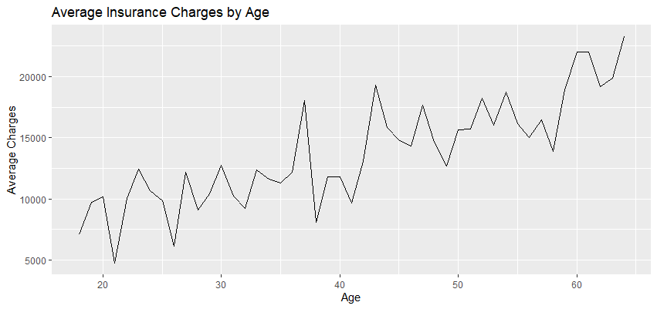
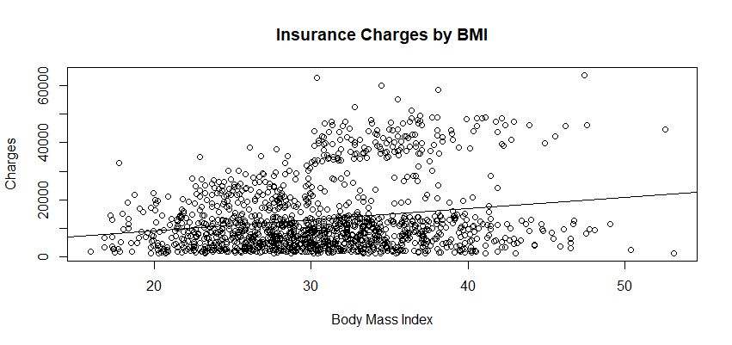
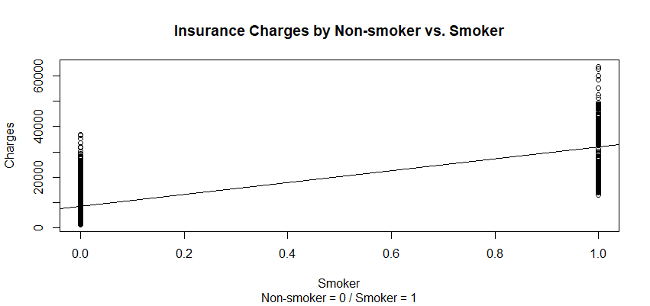
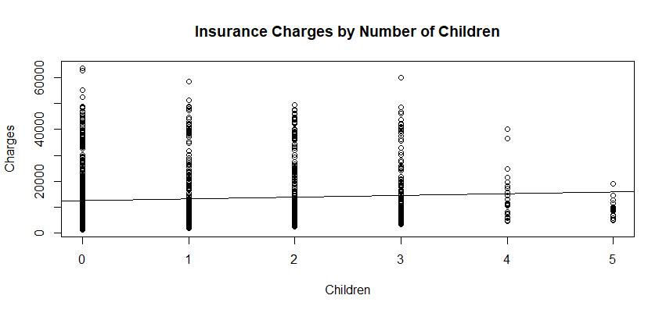
Significant Variables Effects on Charges

Slide 9
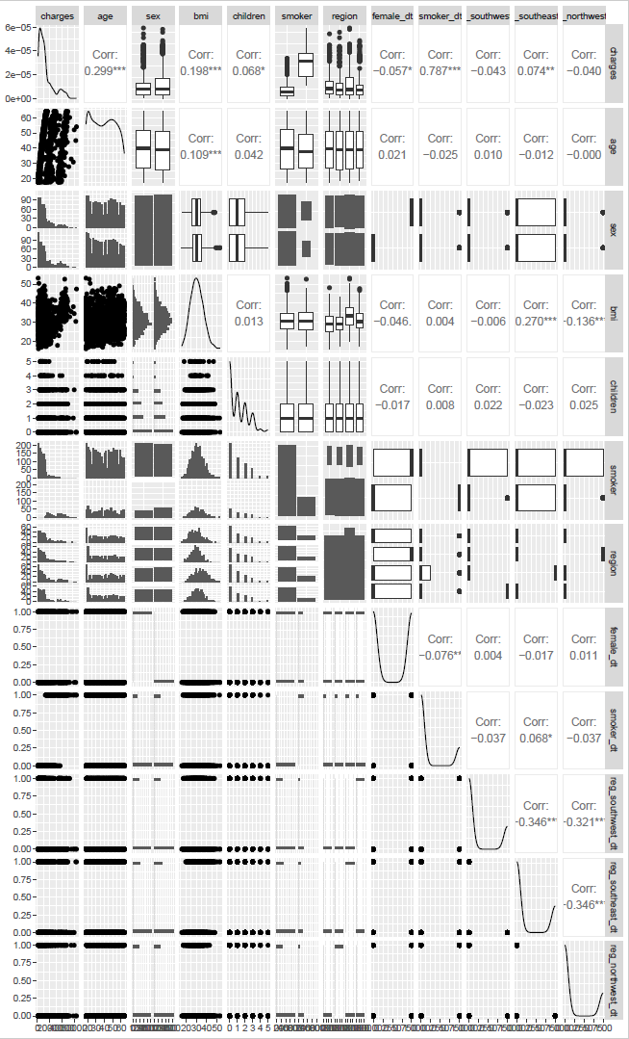
Correlation of Variables
Most significant correlation
Charges and Smoker: 78%
Charges and Age: 30%
Southest Region and BMI: 27%

Slide 10
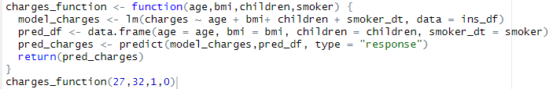
Prediction Model/Function for Business App
Output: $5,631.92

Slide 11
Additional Business Questions
Controllable Variables
BMI
Smoking
Number of Children*
Uncontrollable Variables
Age
*Assumes children aren't already born
R-squared: 74.89% | F-Statistic: <2.2e-16
Variable | Coefficient | P-Value
Intercept | -12102.77 | < 2e-16
Age | 257.85 | < 2e-16
BMI | 321.85 | < 2e-16
Children | 473.50 | 0.000608
Smoker | 23811.40 | < 2e-16

Slide 12
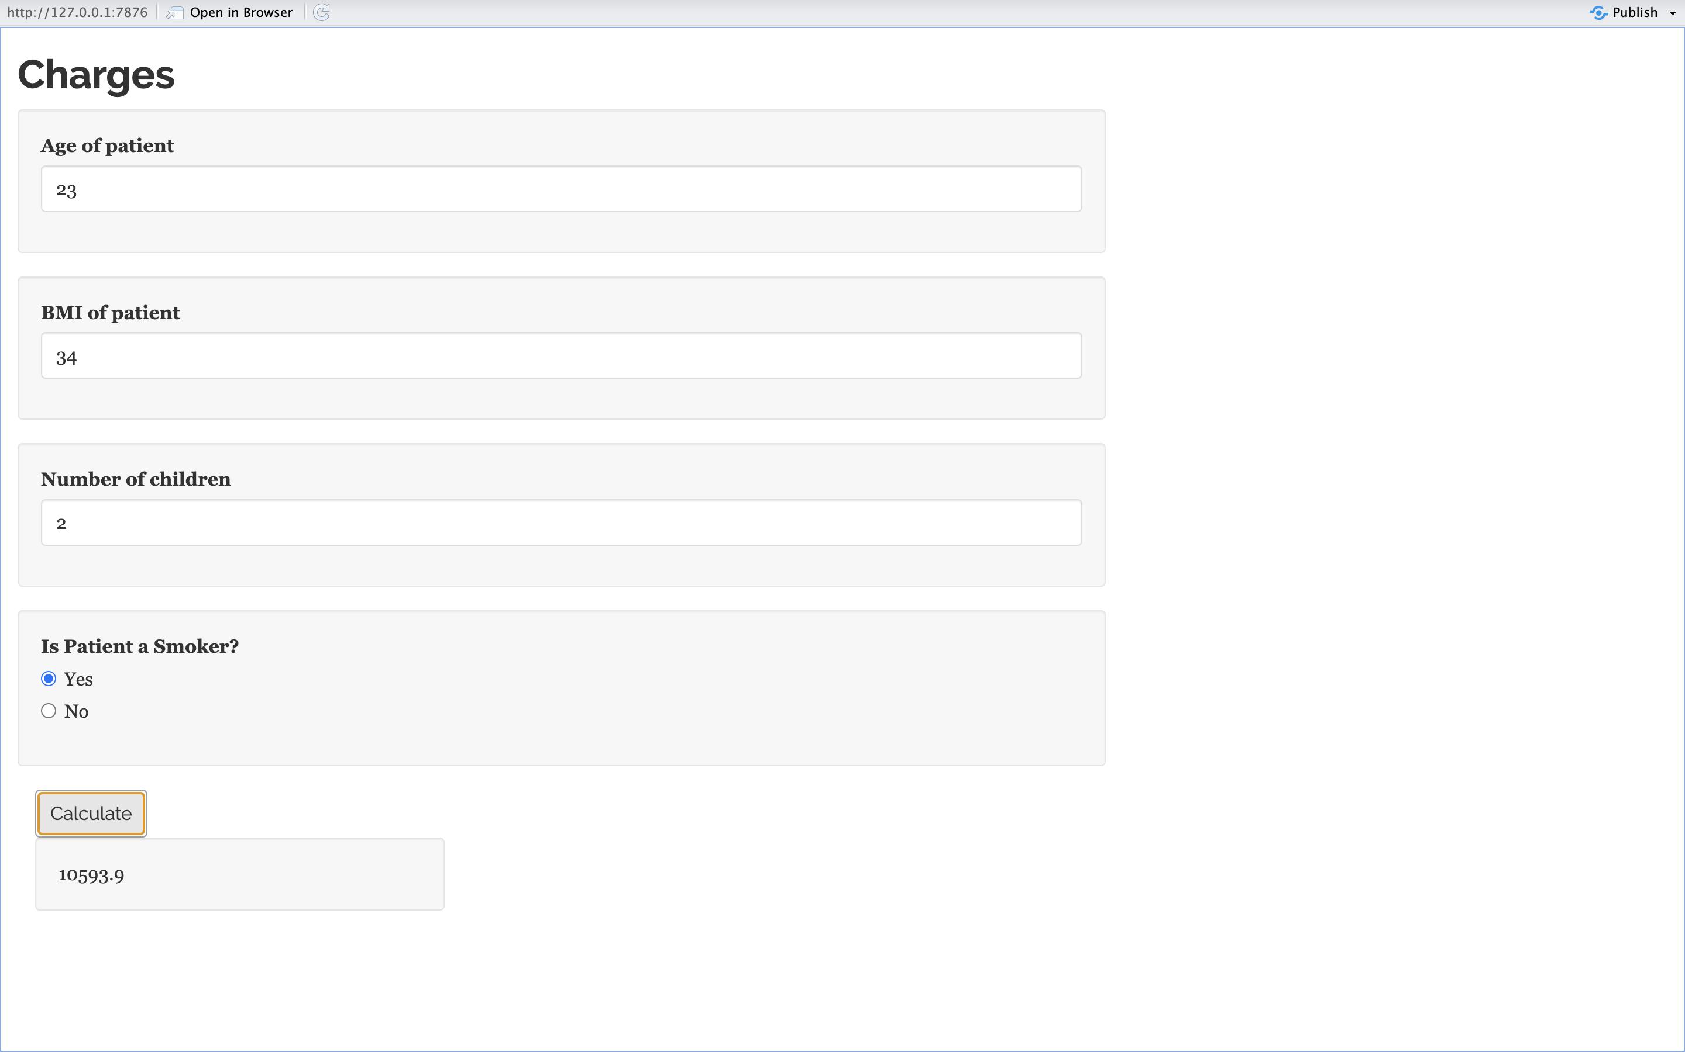
Shiny App for Web User

Slide 13
Limitatations of the Dataset
Several large outliers that may affect assumptions made in the linear regression analysis
Inabilty to address the high average cost of healthcare
Dataset is from one insurance company
Prediction models failing due to global events that disrupt healthcare system, e.g. the COVID-19 pandemic

Slide 14
Future Topics to Address The Limitations
Dataset from various insurance companies and cross analysis of the cost across healthcare systems
Dataset from other sources including government sources on the number of unisured patients and the role they play in the cost of healthcare
Transparancy in medical bills including administrative cost and hidden fees to address discrepancies in the cost

